Slide 1
Mid-Term Presentation
Comparing Approaches to Create Time Series of LMs
Md Touhidul Islam

Slide 2
Agenda
Introduction
Research Goal
Current Result
Data
Q & A
Methodology

Slide 3







Motivation
Some question's answers get change over time.
Which political party to support?
Which product to buy?
Where should I go on holiday?
Where to invest?
Which dating app to use?
Product
Pools
Business
Politics
Some Examples
Consumer Confidence index.
Political Polls.
Approval Rating.
Business Confidence Index.
Product approval rating.
Happy
Sad
Time

Slide 4

Motivation
Current Approach to detecting change in people opinion
Problem with survey:
Collecting data for survey is expensive.
It is hard to get large number of participants.
Human emotions are constantly changing rapidly. Especially, in the world of social media. By the time we get the survey results, the trend may have already changed.
Time-consuming data collection process

Slide 5

Motivation
Research Gap: Research seeks to determine whether MTALM can be used to track the change of emotion/opinion over time.
Research Goal: Use Masked Time aware language model to calculate changes in emotion
Comment
Opinion
Review
Concern
Thought
Utilize user generated data
Use power of LM
Masked Time aware language model = MTALM

Slide 6
Research Question:
Can the MTALM detect the change in people's opinion change?
If It can, what is the best approach to do it?
Does training with more epochs result in overfitting? Epoch 1 VS Epoch 2 vs Epoch 3
Does asking the same question multiple times in different ways provide a better repeatable result than asking questions simultaneously? Single Query Vs. Multiple Query.
Calculate value based on the single token or multiple token.
Can this approach outperform existing methods?

Slide 7





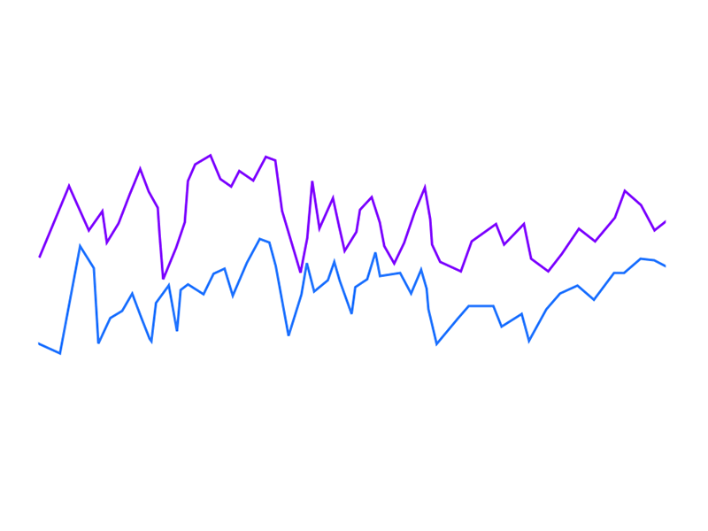
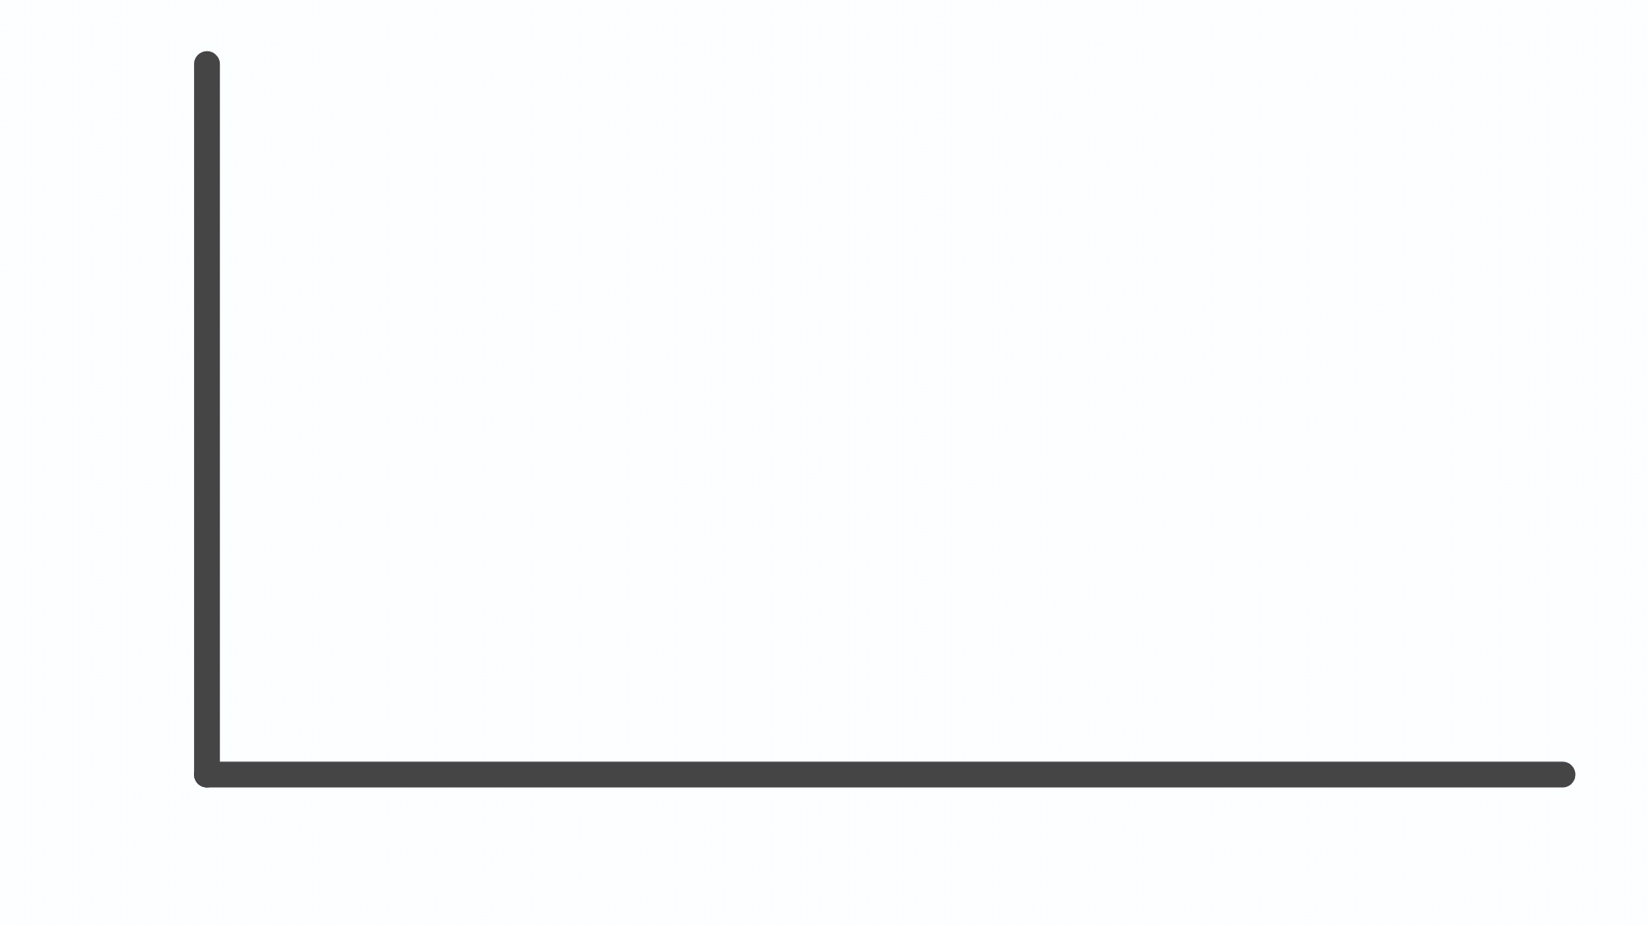

Workplan
Yougov survey result
Asking the same question to all 200 models
Pretrain Bert Model
On 850m tweets until 2019
MTALM
200 model
Tweets from 200 weeks
July 2019 – March 2023
Plotting the results on Month by month
Compare yougov result with mask model

Slide 8




Work Plan
Training Model:
Different training approach:
We are training the model with a much smaller learning rate.
Reduce the number of epochs and save checkpoints at each epoch.
Use a different model than before, which has been pre-train on data up to 2019.
Query Model:
Ask the same question to all differently trained models.
Different Query approach:
Single Query for each Question.
Multiple Query for each Question.
Calculation:
Different calculation methods:
Calculating emotion from the single token
Calculating emotion from all tokens based on the similarity with the targeted token
Compare results from different approaches:
Compared with existing solutions, such as dictionary-based and sentiment
take the base model and ask the same question but with a time anchor.
Try with shifting timeframe.

Slide 9
Training Models
Pre-train Language Model
Stage 1: Taking a pretrain model as a base model. Because the amount of data in a week is insufficient to train the model from scratch
.
Change: Tran with a different model that trains on tweets up to 2019
Stage 2: Preprocess data from all 200 different weekly tweets separately.
Change: Train all models with an equal number of 200k tweets.
Data 1
Data 2
Data 3
Data 4
Data 5
Data 200
Train 1
Train 2
Train 3
Train 4
Train 5
Train 200
Stage 3: Train all 200 fresh models with different weekly data.
Change: Reduce epoch number to 3 and compare results with each epoch.
Model 1
Model 2
Model 3
Model 4
Model 5
Model 200
Stage 4: Store all 200 models.
Change: Save each model on every epoch

Slide 10
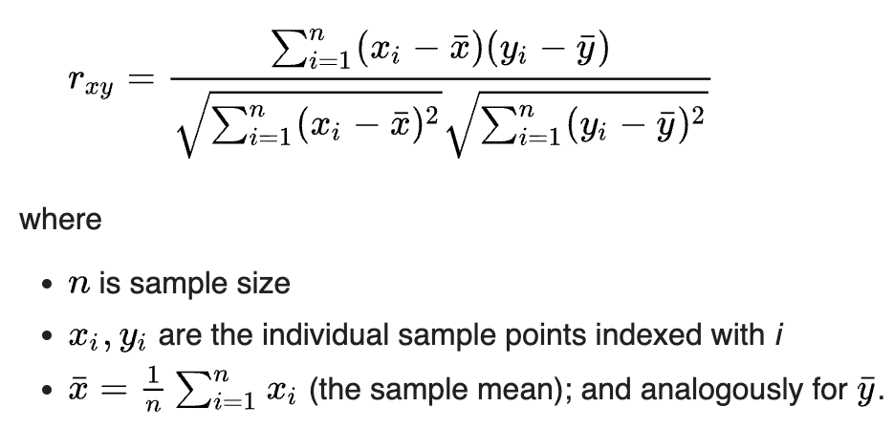
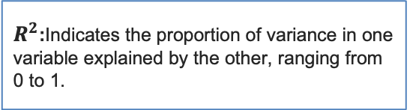
Pearson's Correlation
Purpose: Measures the strength and direction of a linear relationship between two variables. A survey outcome is compared to the k-weekly text window.
(Correlation Coefficient): Measures the strength and direction of a linear relationship between two variables, ranging from -1 to 1
$R^{2}$:Indicates the proportion of variance in one variable explained by the other, ranging from 0 to 1.
p-value: Tests the statistical significance of the correlation, showing whether the observed relationship is likely due to chance.

Slide 11
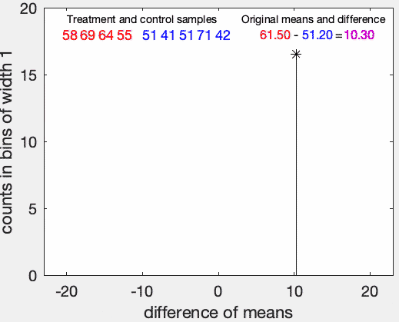
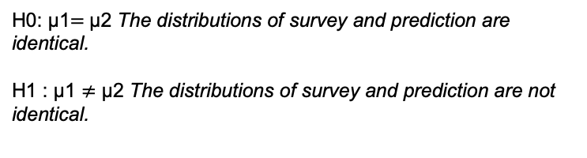
Permutation Testing
Random Re-sampling: The data is shuffled (permuted) often to generate new samples.
Test Statistic Comparison: The test statistic (e.g., mean difference) is calculated for each permuted sample and compared with the actual observed statistic.
H0: μ1​$=$μ2​ The distributions of survey and prediction are identical.
H1​ : μ1 ​$≠$ μ2​ The distributions of survey and prediction are not identical.

Slide 12
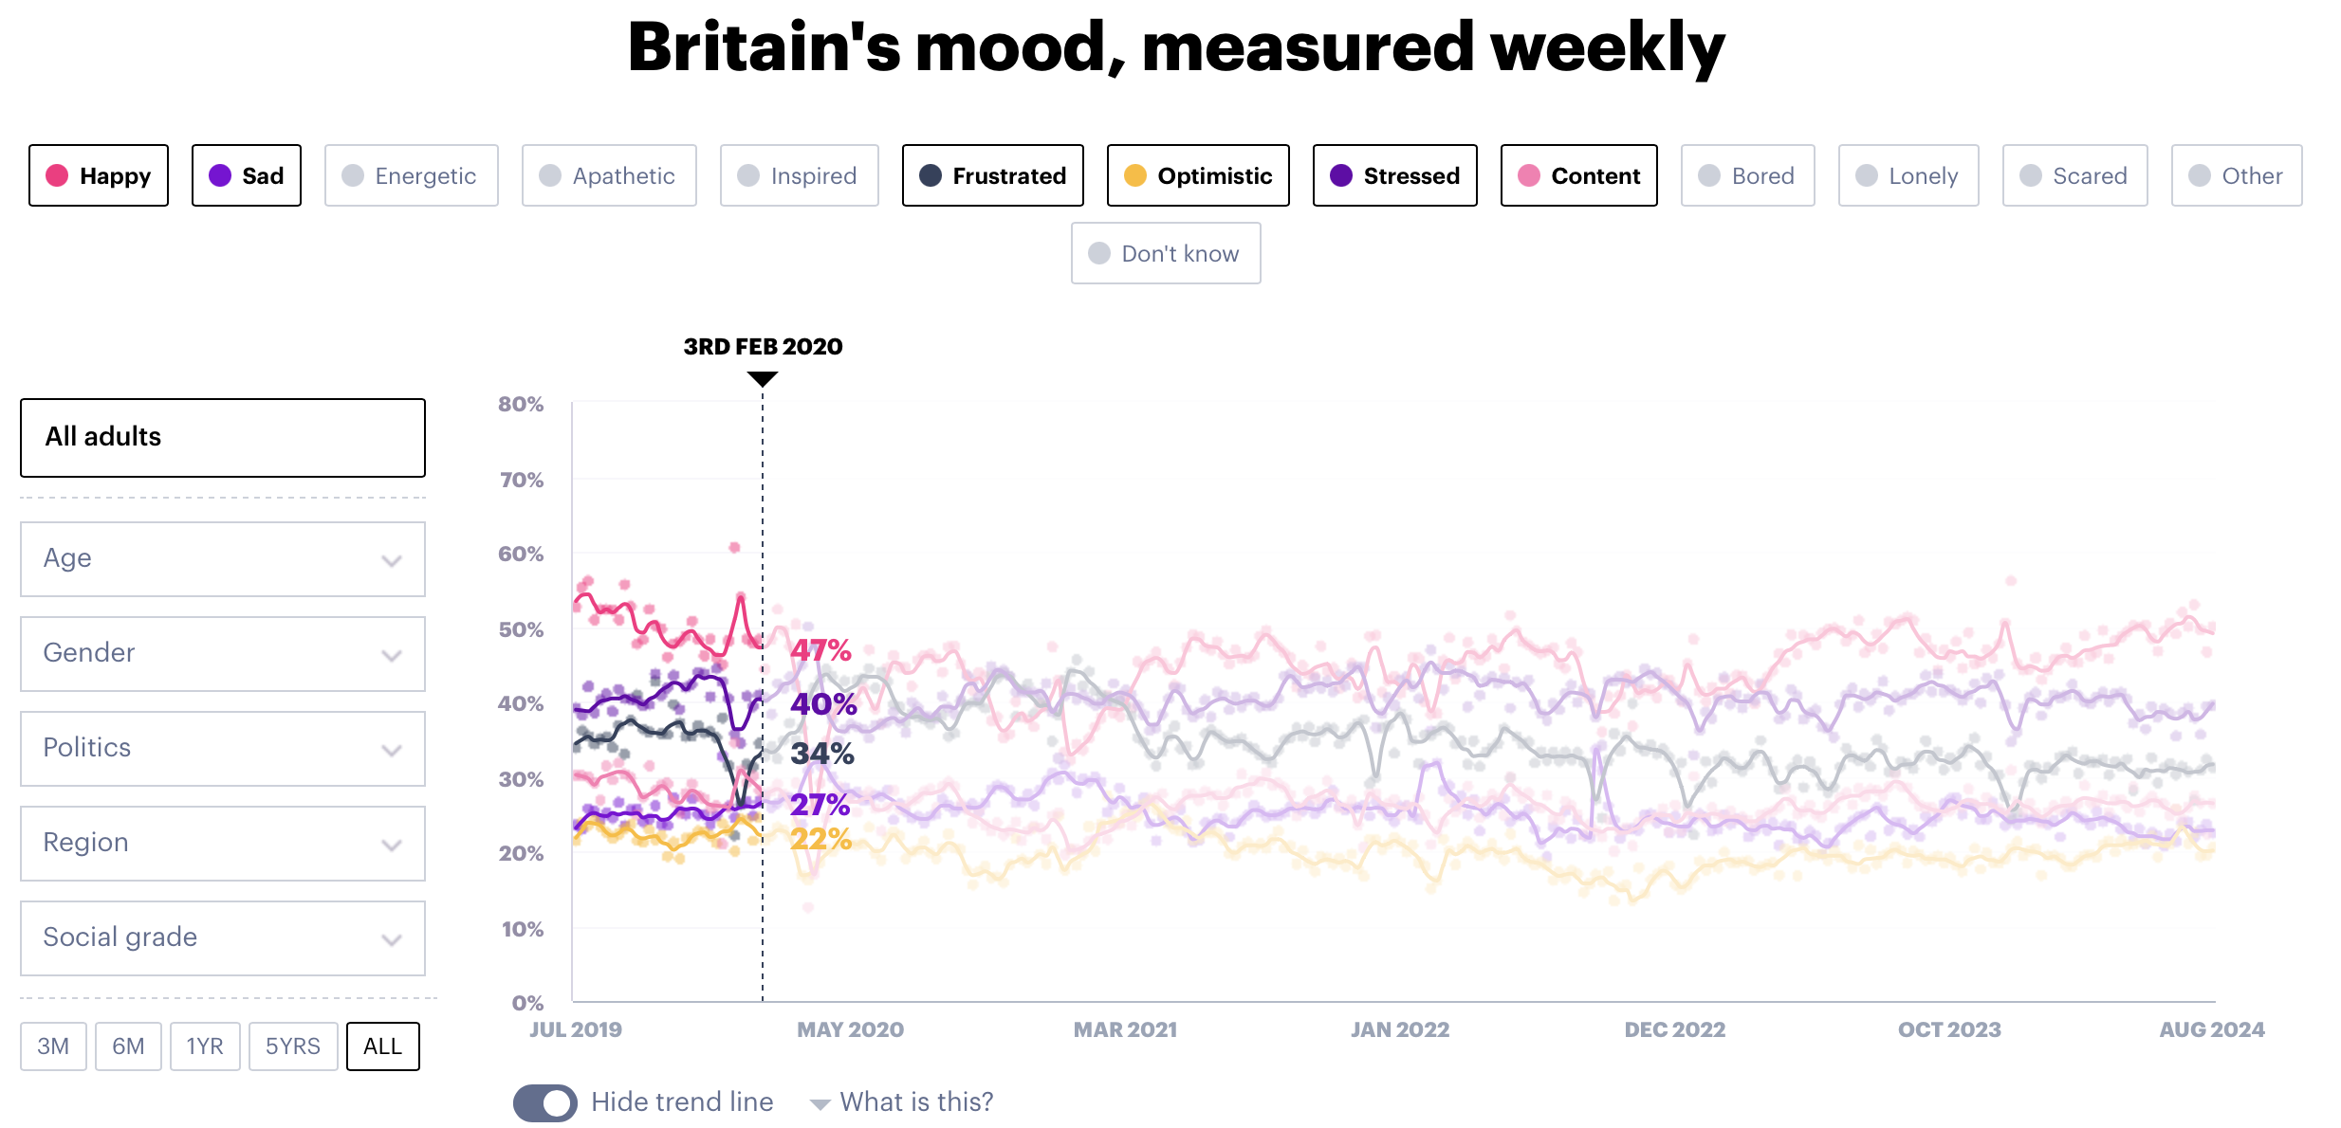
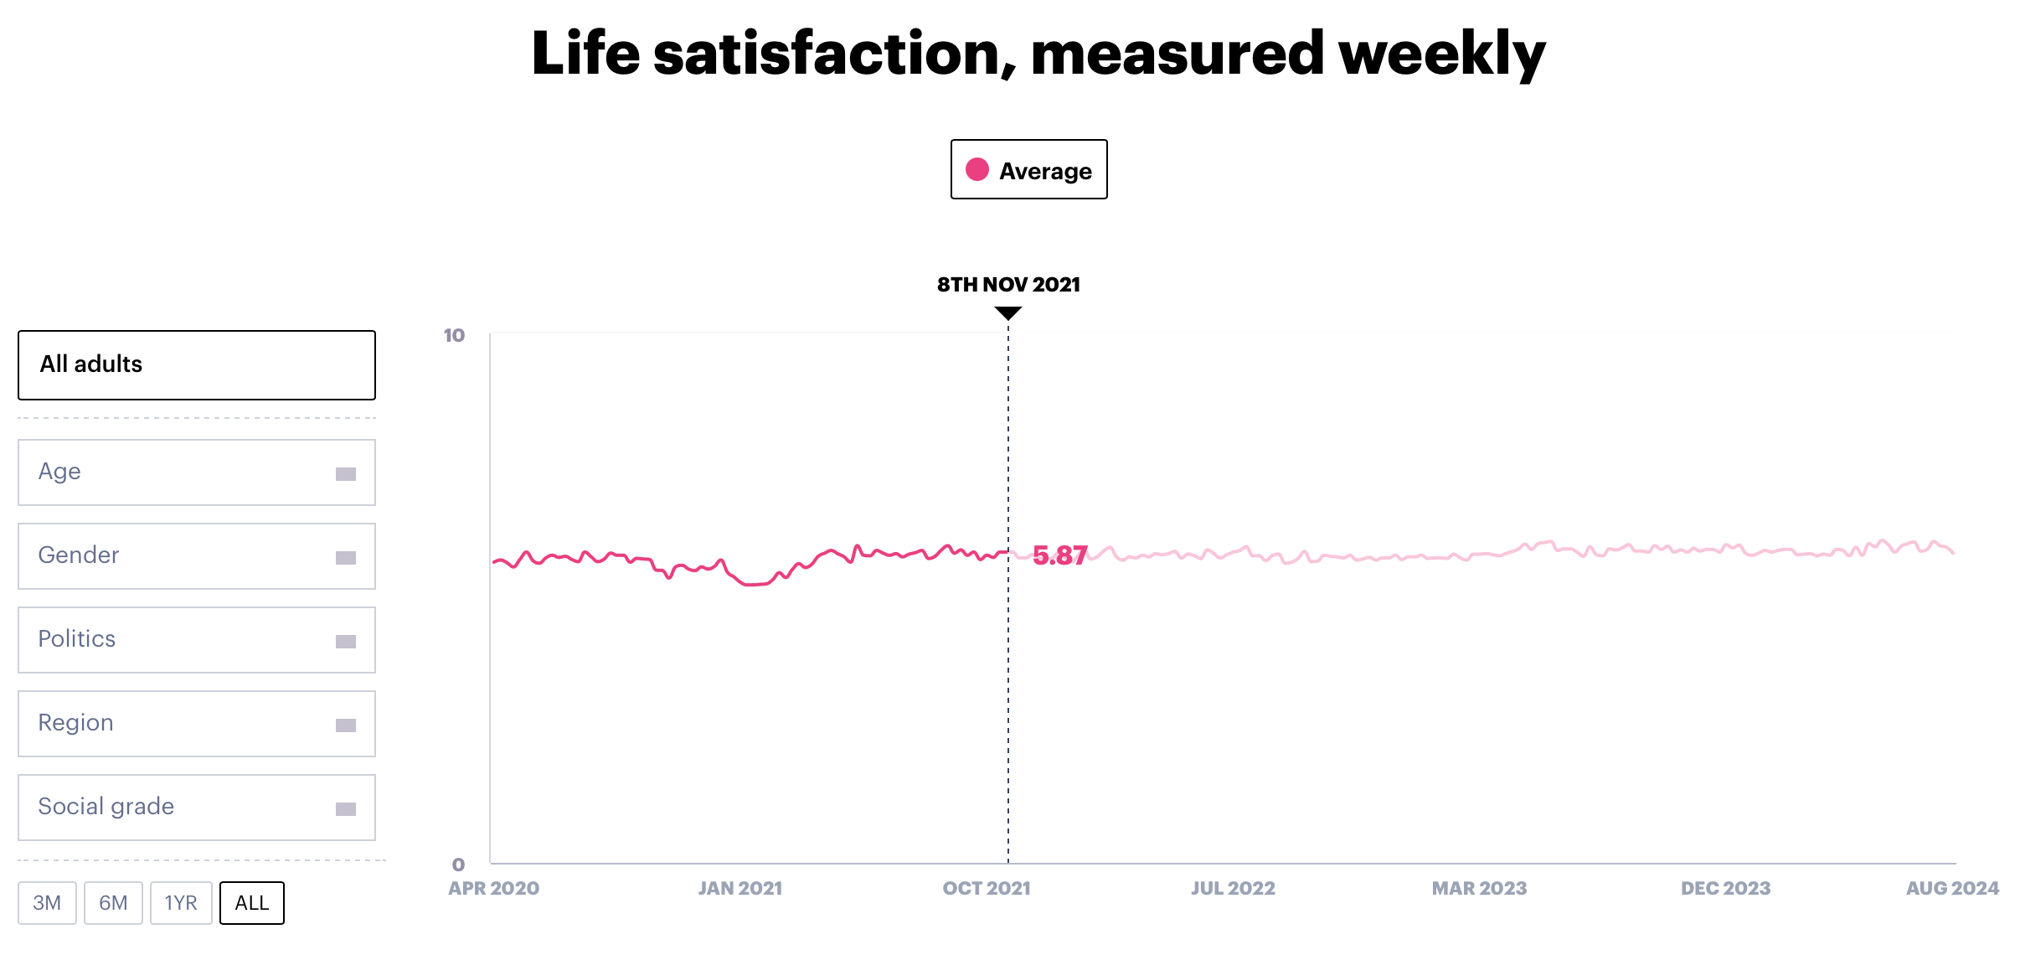
Survey Question (Gold standard)
Survey results are gathered from YouGov, which tracks the emotions and life satisfaction of the British population on a weekly basis.

Slide 13
what is the best approach to do it?
Research question 2:
Does training with more epochs result in overfitting? Epoch 1 VS Epoch 2 vs Epoch 3
Does asking the same question multiple times in different ways provide a better repeatable result than asking questions simultaneously? Single Query Vs. Multiple Query.
Calculate value based on the single token or multiple token.

Slide 14
Query
Broadly speaking, <mask> is the emotion that best describes your mood and/or how you have felt in the past week.

Slide 15
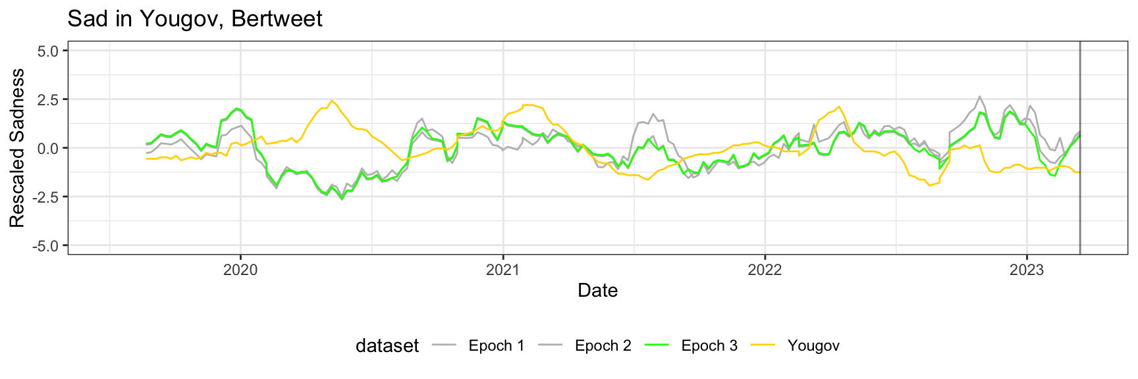
Does training with more epochs provide better result? Epoch 1 VS Epoch 2 vs Epoch 3
Except for mismatches in a few places, the difference is minimal
Epoch 3 vs GS

Slide 16
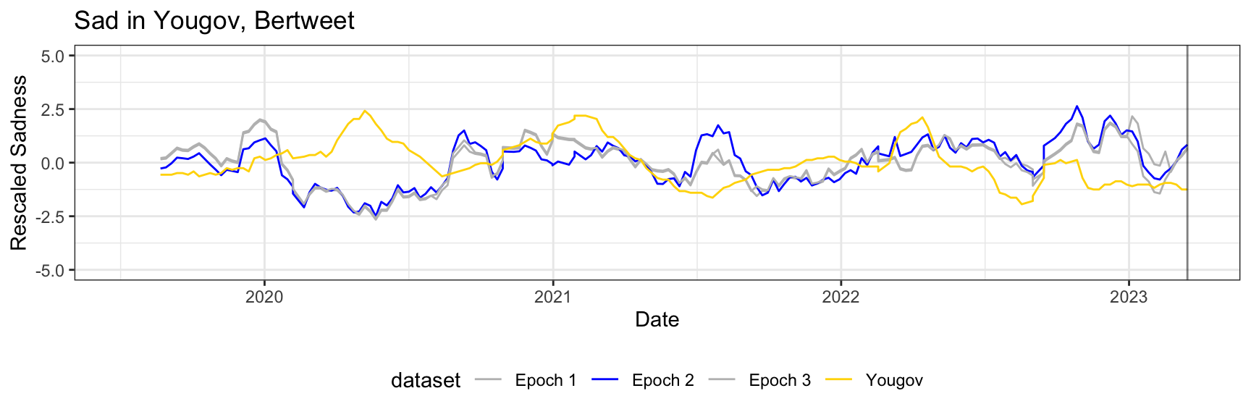
Does training with more epochs provide better result? Epoch 1 VS Epoch 2 vs Epoch 3
But it still doesn’t align perfectly with GS
Epoch 2 vs GS

Slide 17
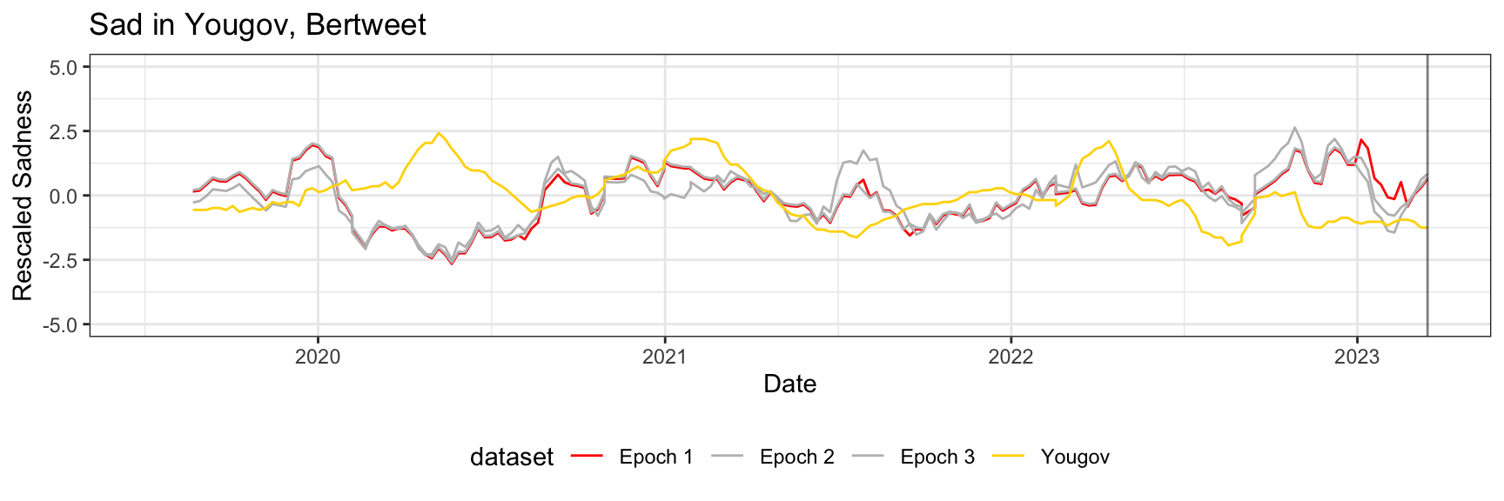
Does training with more epochs provide better results? Epoch 1 VS Epoch 2 vs Epoch 3
Due to almost all values being clustered around the middle and higher volatility, it is hard to spot any trend
Epoch 1 vs GS

Slide 18
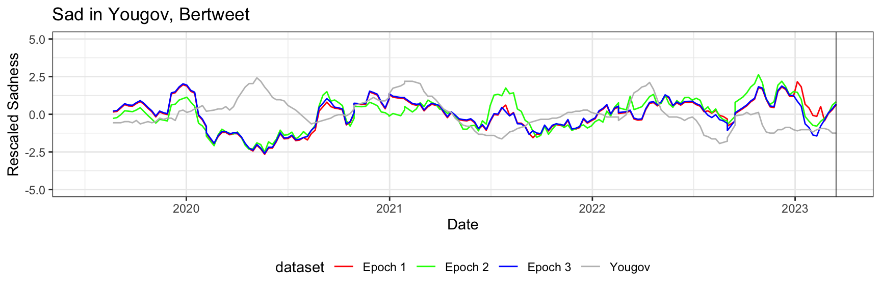
Does training with more epochs provide better result? Epoch 1 VS Epoch 2 vs Epoch 3
The difference between epochs is very small

Slide 19
Average
Pearson's correlation
 | Epoch 1 | Epoch 2 | Epoch 3
Correlation | 0.221104 | 0.212596792 | 0.209049497
P Value | 0.1792547 | 0.177367881 | 0.18398982
MSE | 2.2623563 | 2.393220333 | 2.351717583
Adjusted R-squared | 0.0621981 | 0.060402171 | 0.060889634
Permutation Correlation
Correlation | 0.2764171 | 0.313670091 | 0.383237869
p-value | 0.4713325 | 0.4186575 | 0.3317584

Slide 20
Does training with more epochs provide better result? Epoch 1 VS Epoch 2 vs Epoch 3
The difference between epoch 1 and epoch 3 are not significantly different
Additional training through epoch 2 and 3 is unnecessary, while it don’t provide additional value

Slide 21
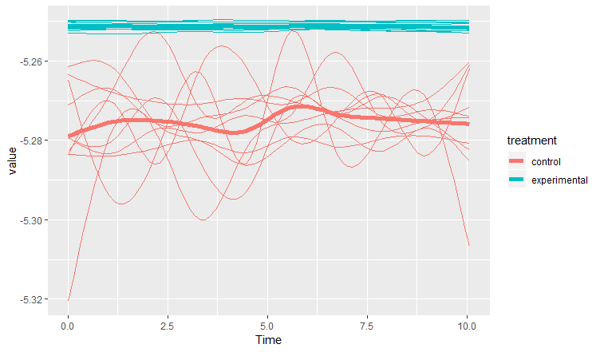
There is a problem still remains
The result is heavily dependent on the query. A simple change in question can change the result dramatically.
The result is not consistent, dependent on the phrasing of the question
Possible Solution
Run the same question multiple times, with different writing styles and get the average results
Variations due to questions will cancel each other out

Slide 22
Average of Multiple queries
Broadly speaking, <mask> is the emotion that best describes your mood and/or how you have felt in the past week.
Broadly speaking, the emotion <mask> best describes your mood and/or how you have felt in the past week.
Broadly speaking, which of the following best describes your mood and/or how you have felt in the past week? Please select all that apply <mask>.
Broadly speaking, which of the following best describes your mood and/or how you have felt in the past week? Please select all that apply <mask>.
Hopefully, the variation due to queries will cancel out, if the number of queries is large enough
We used Chat GPT to create additional question. Total number of question use for testing was 3

Slide 23
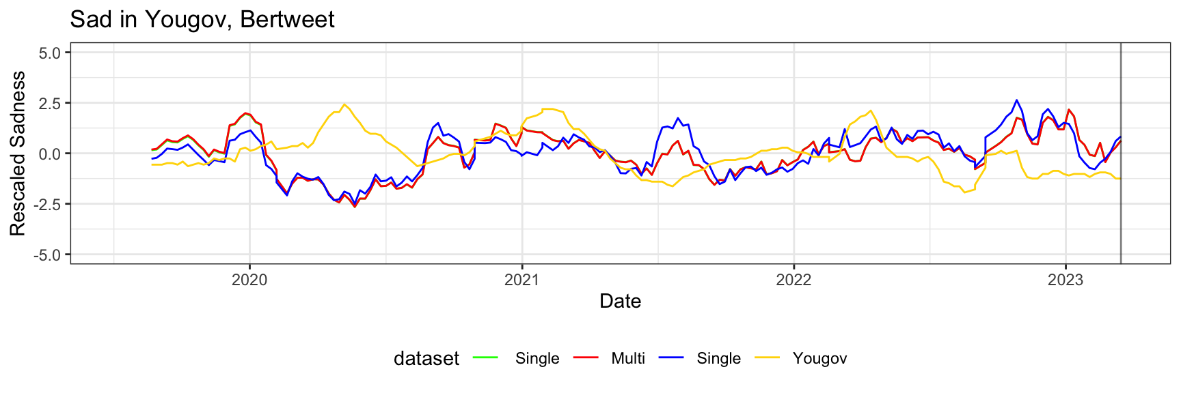
Single Query Vs. Multiple Query.
The results here also don’t differ significantly

Slide 24

Single Query Vs. Multiple Query.

Slide 25
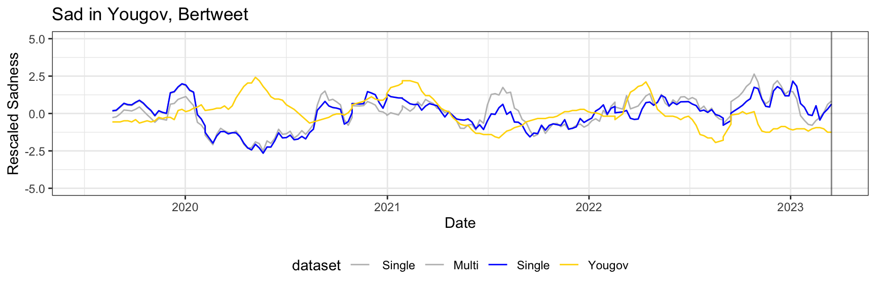
Single Query Vs. Multiple Query.

Slide 26
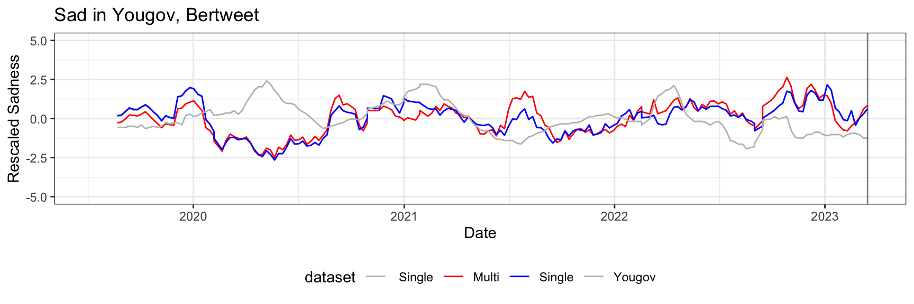
Single Query Vs. Multiple Query.

Slide 27
Choosing multi-query over single
Results can vary heavily based on the query being performed.
In multi-query, the first query performs better than the other because It has been chosen carefully.
It also means the other query has performed worse than the average.
One smaller grammatical or linguistic mistake can change the results hugely
Multi-query is more consistent

Slide 28

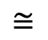
Similarity base approach
I am feeling happy
I am feeling joyful
$$≅$$
Cheerful, Delighted, Ecstatic, Elated, Enraptured, Exultant, Glad, Gleeful, jolly, joyful, joyous, jubilant, merry, mirthful, Overjoyed, thrilled, up upbeat
There are many synonyms for the word Happy
So, when we are only taking tokens happy, we are throwing away all other tokens that also express happiness.
.
Also, tokens in the top tend to be more accurate than the bottom

Slide 29
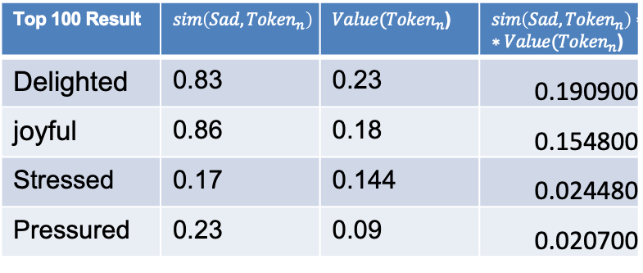
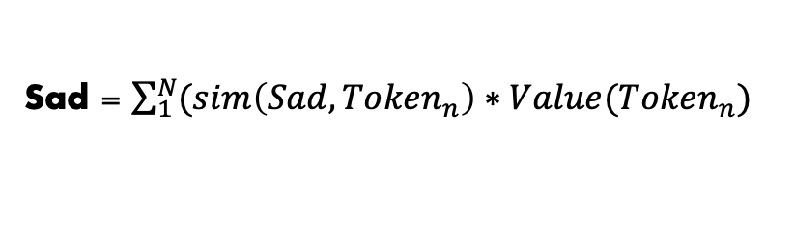
Similarity base approach
Select top n token
Top 100 Result | $$sim\left(Sad,{Token}_{n}\right)$$ | $Value({Token}_{n}$) | $sim\left(Sad,{Token}_{n}\right)∗∗Value({Token}_{n}$)
Delighted | 0.83 | 0.23 | 0.190900
joyful | 0.86 | 0.18 | 0.154800
Stressed | 0.17 | 0.144 | 0.024480
Pressured | 0.23 | 0.09 | 0.020700
Calculated Similarity between 1 until n token with targeted token sad
Multiply it with the value of token n
Sad = $\sum_{1}^{N}{(sim\left(Sad,{Token}_{n}\right)∗Value({Token}_{n})}$
Sum all the values to get the target value
It not only considers targeted tokens but also all synonyms
Similarity value:
Similarity Calculation: Cosine similarity
Model:- all-MiniLM-L6-v2

Slide 30
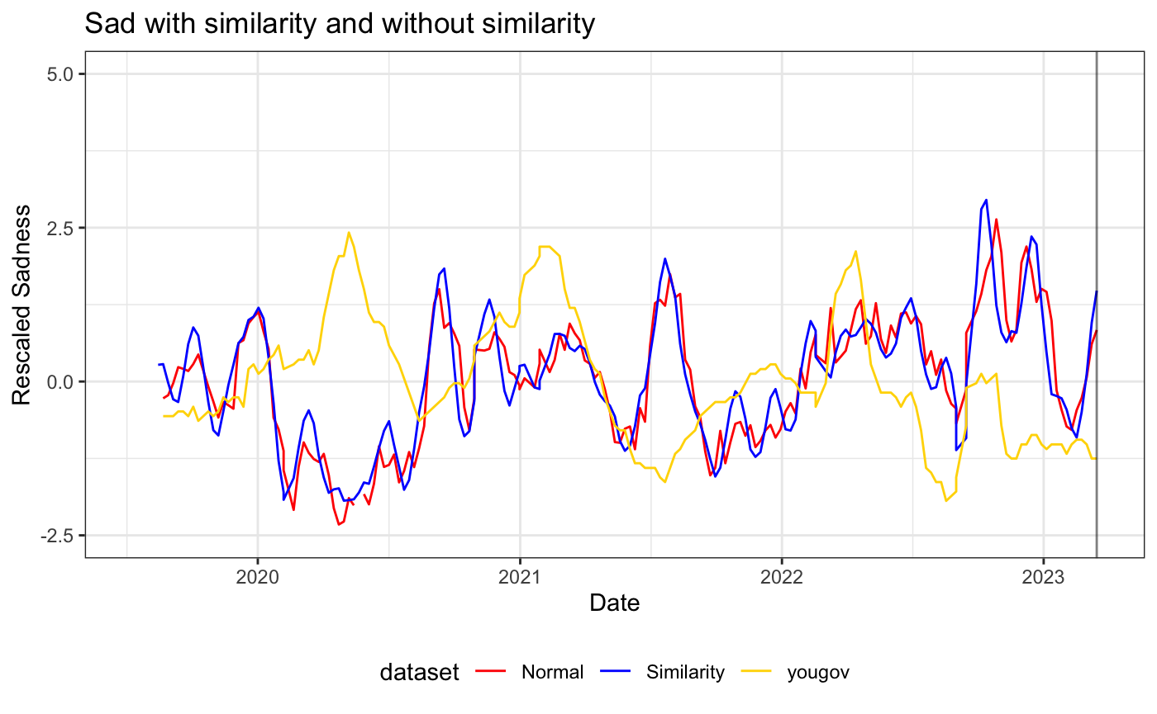
Similarity base approach
The mismatch in some places remains and values don’t differ significantly

Slide 31
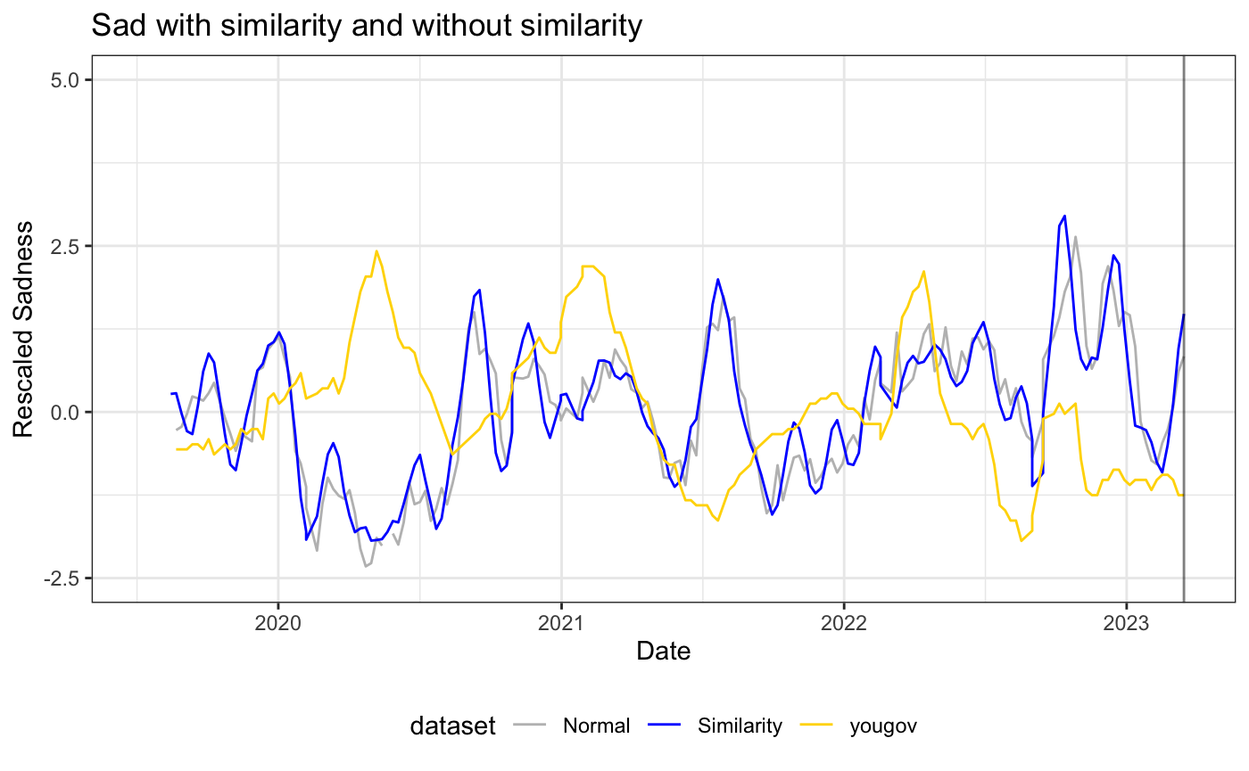
Similarity base approach
The similarity base approach has less volatility

Slide 32
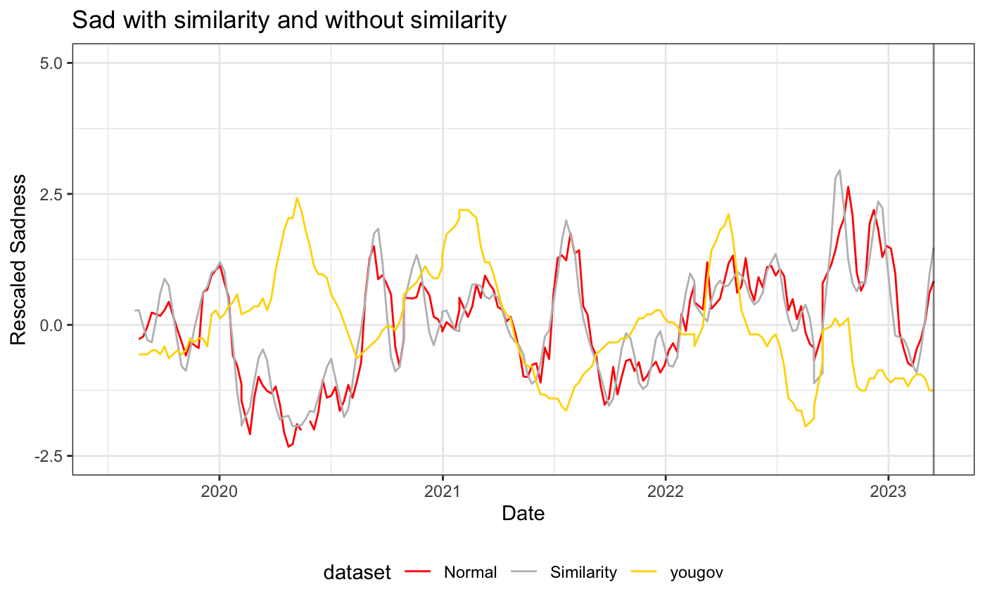
Similarity base approach
Compare to single token approach

Slide 33

Similarity base approach
Still overall visual difference is little

Slide 34
Comparison
Pearson's correlation
 | Similarity | Non-similarity
Correlation | 0.2090495 | 0.21645913 | Higher value is better
P Value | 0.18398982 | 0.22033971 | Lower value is better
MSE | 2.35171758 | 2.30463275 | Lower value is better
Adjusted R-squared | 0.06088963 | 0.06811345 | Higher value is better
Permutation Correlation
Correlation | 0.38323787 | 0.34126046 | Higher value is better
p-value | 0.3317584 | 0.38845741 | Lower value is better

Slide 35
Conclusion: Calculate value based on the single token vs. multiple token.
Overall similarity base methods perform better and show lower volatility and robustness

Slide 36
Can it detect the change in people's opinion change?
Research question 1:
Does training give better results? Or does the base model already contain temporal information?

Slide 37
Can it detect the change in people's opinion change?
Base Model: Today is Wed, December 4th, 2021. Location UK. Which of the following best describes your mood and how you have felt in the past week? Please select all that apply <mask>.
Base Bartweet model
Ask the same question with date and Place
Results compared with Fine tuned model
Instead of
Trained model:- Which of the following best describes your mood and how you have felt in the past week? Please select all that apply <mask>.

Slide 38
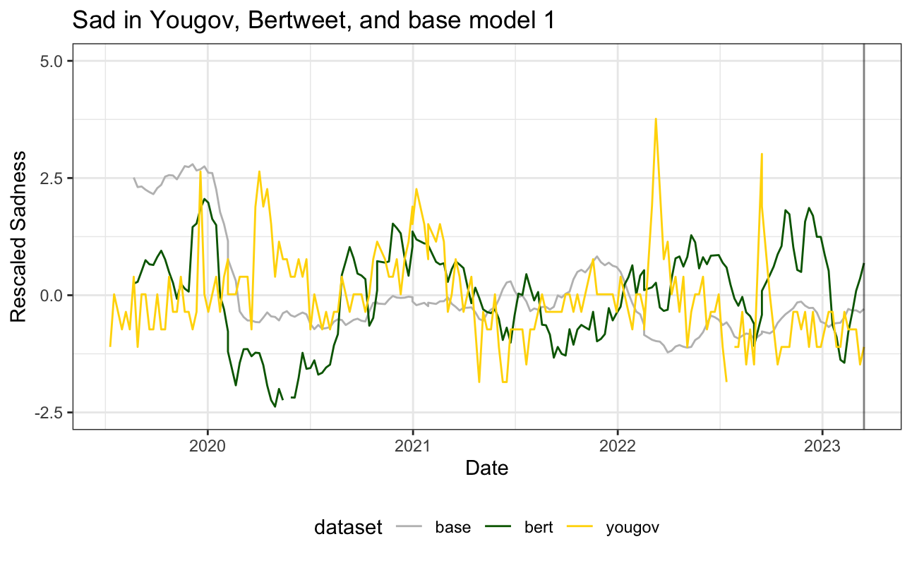
Bertweet FT vs . Baseline 1

Slide 39
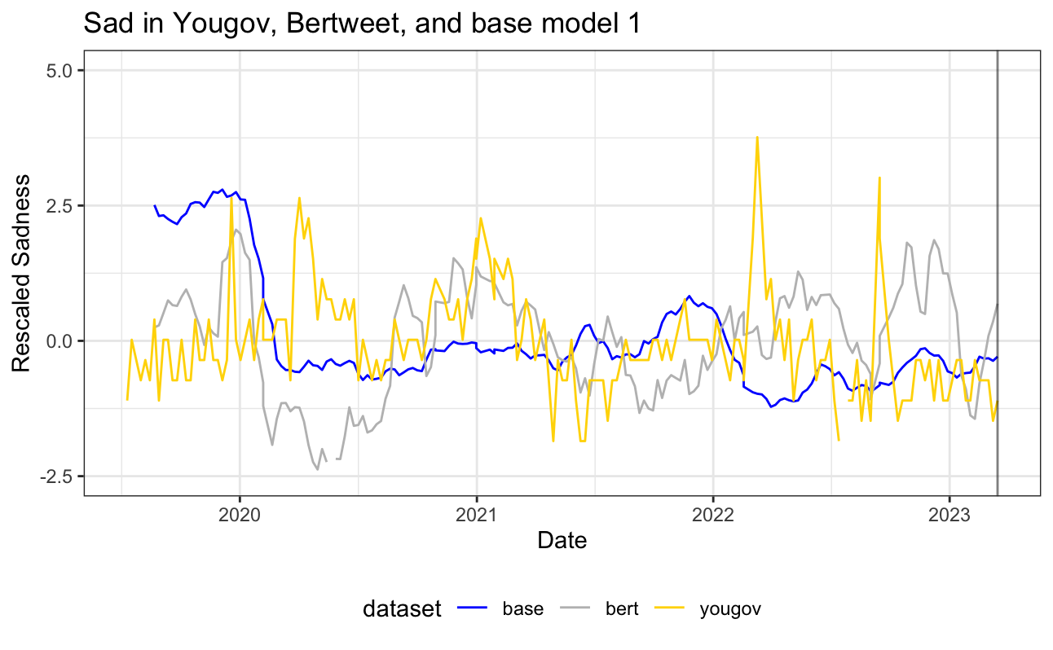
Bertweet FT vs . Baseline 1
The result for baseline 1 is almost flat

Slide 40
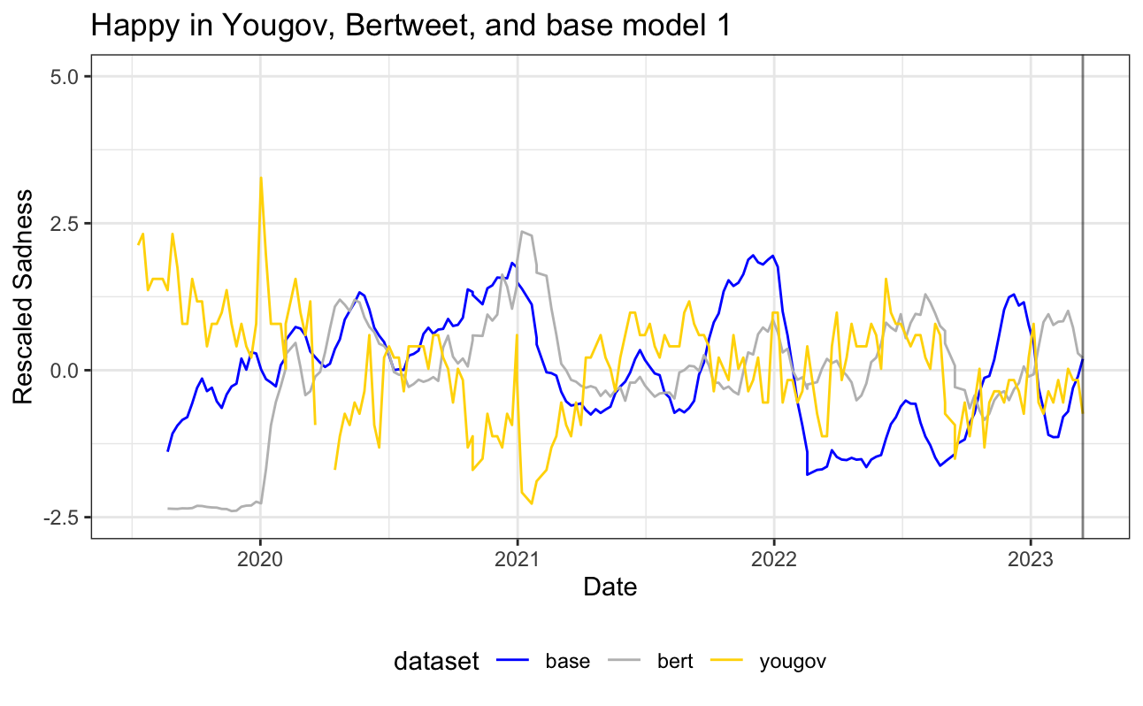
Bertweet FT vs . Baseline 1

Slide 41
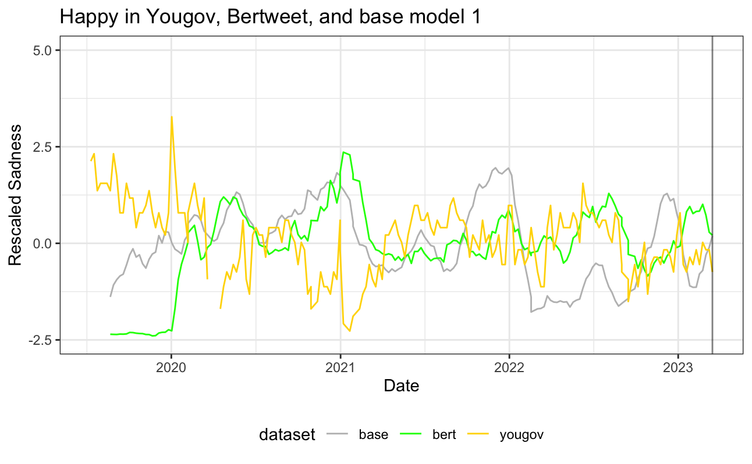
Bertweet FT vs . Baseline 1

Slide 42
Bertweet FT vs . Baseline 1
Pearson's correlation
 | Tuned Model | Base Model
Correlation | 0.209049 | 0.14526 | Higher value is better
P Value | 0.18399 | 0.329369 | Lower value is better
MSE | 2.351718 | 2.046847 | Lower value is better
Adjusted R-squared | 0.066927 | 0.035869 | Higher value is better
Permutation Correlation
Correlation | 0.383238 | 0.320689 | Higher value is better
P Value | 0.331758 | 0.405668 | Lower value is better

Slide 43
Bertweet FT vs . Baseline 1
Although base model 1 contains some temporal information, fine-tuning the model results in better results

Slide 44
Can it outperform existing methods?
Research question 3:
Compare the result with the existing solutions.

Slide 45
Bertweet FT vs . Baseline 2
LIWC (Linguistic Inquiry and Word Count, García et al., 2021)
Tweets are separated by weeks: tweets are aggregated into weekly
Week 1 | T1, t2, t3, t4, t5…
Week 2 | T1, t2, t3, t4, t5…
Week 3 | T1, t2, t3, t4, t5…
Word Counting: The input text is processed by counting the occurrences of words that belong to each category in the LIWC dictionary.
 | Happy | Sad | Joy | Scared | Total
Week 1 | 14 | 25 | 23 | 21 | 102
Week 2 | 23 | 34 | 45 | 34 | 105
Week 3 | 43 | 34 | 45 | 34 | 120
Percentage Calculation: The raw word counts are then converted into percentages, representing the proportion of words in the text that fall into each category.
 | Happy | Sad | Joy | Scared
Week 1 | 14% | 25% | 23% | 21%
Week 2 | 23% | 34% | 45% | 34%
Week 3 | 43% | 34% | 45% | 34%
(Number of words in category / Total number of words in text) * 100%

Slide 46
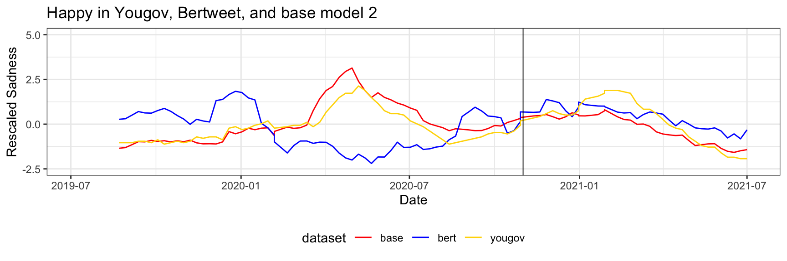
Bertweet FT vs . Baseline 2
Where Bertweet fails to match GS,
Baseline 2 performs surprisingly well

Slide 47
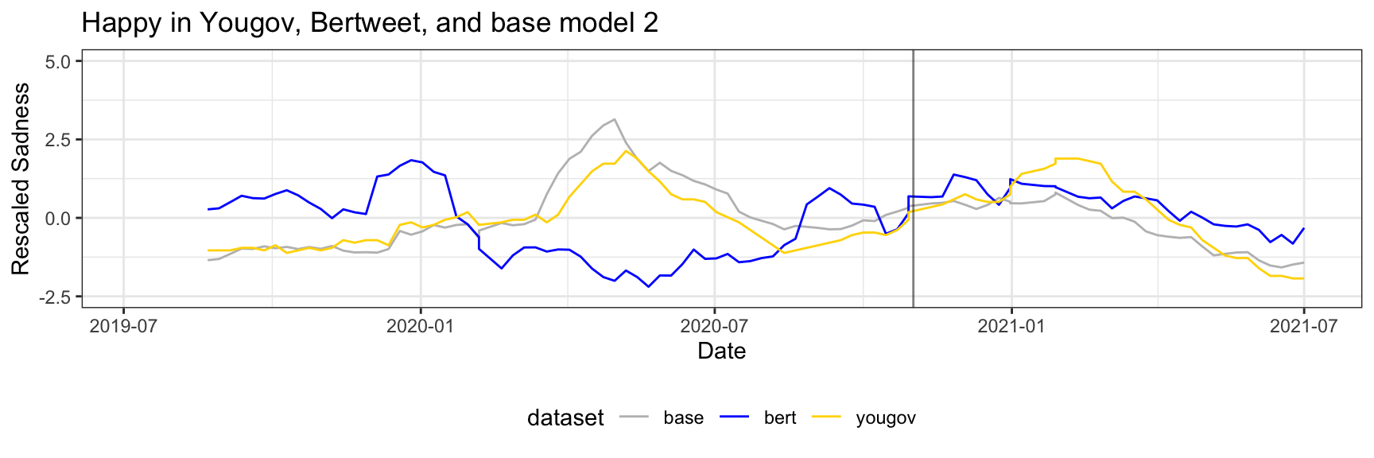
Bertweet FT vs . Baseline 2

Slide 48
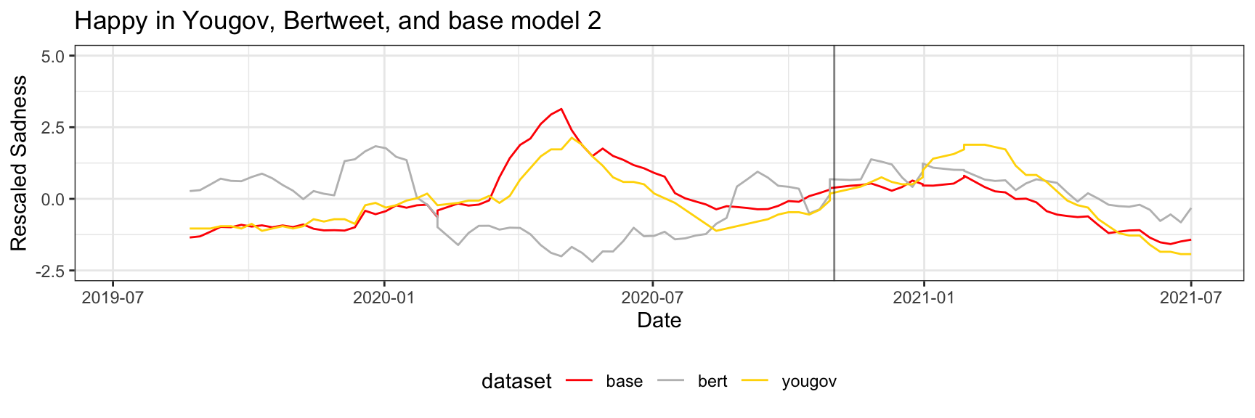
Bertweet FT vs . Baseline 2
Baseline 2 almost perfectly aligns with GS

Slide 49
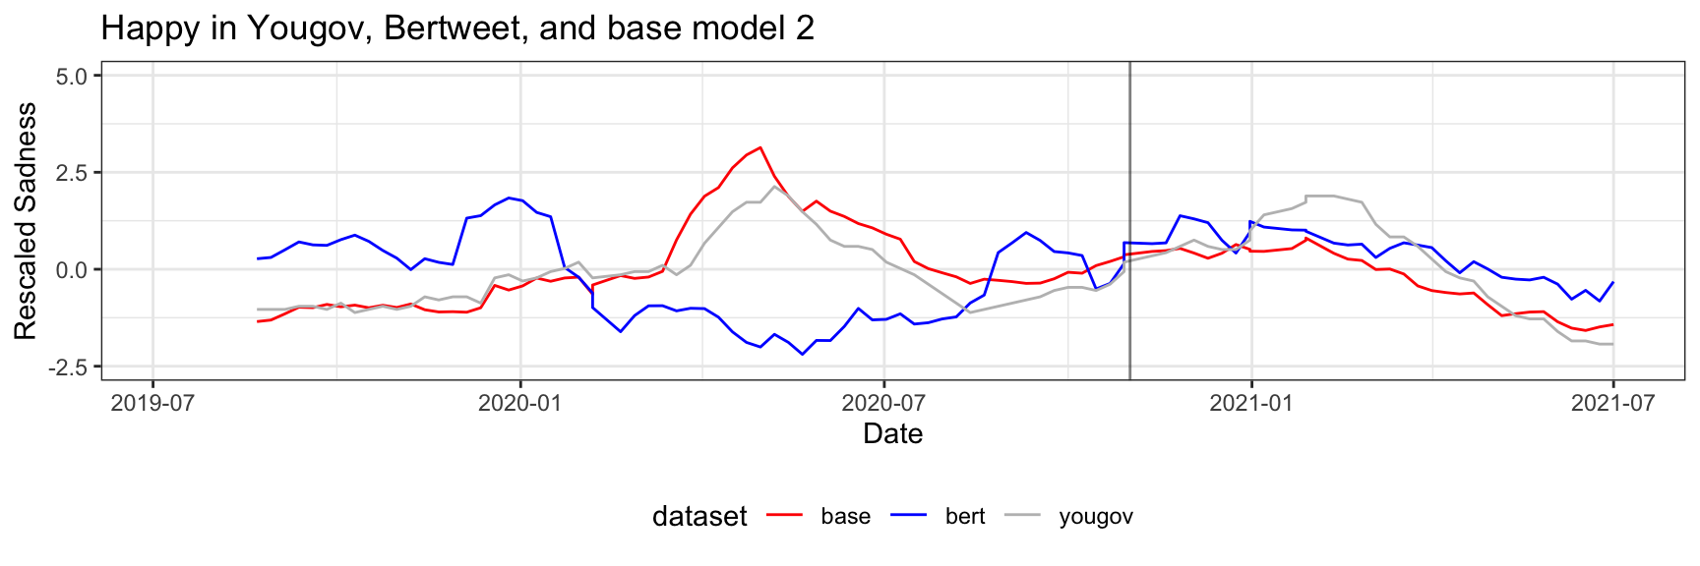
Bertweet FT vs . Baseline 2

Slide 50
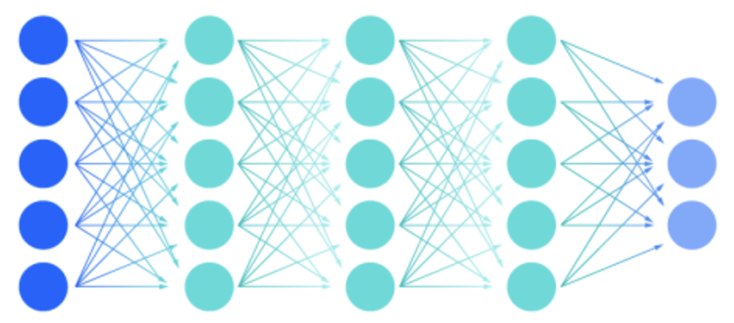
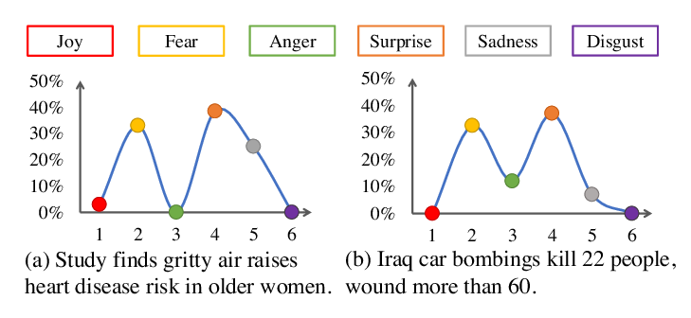
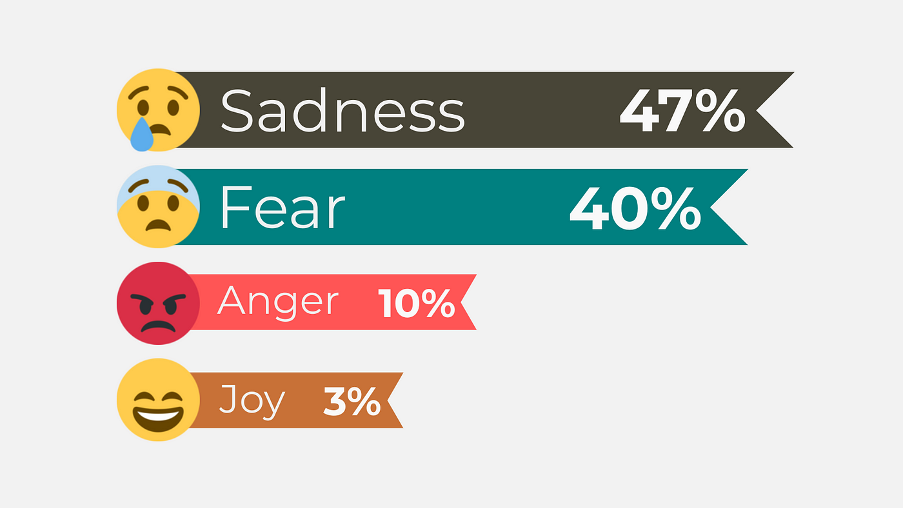
Emotion macroscope - RoBERTa (García et al., 2021)
Model: Take the RoBERTa-base language model and add a layer to the deep neural network.
Sadness
Fear
Joy
Supervised Training: The model is trained on the SemEval 2018 emotion dataset (Mohammad et al., 2018).
SemEval 2018: 1,400 tweets per emotion (anger, fear, joy, sadness)
Calculate sentiment: Three emotions of interest for our study: sadness, fear, and joy. Calculate the score for each tweet
Aggregated to estimate the overall sentiment for a given period
Value = ∑(Sentiment score of all tweets containing target word)

Slide 51
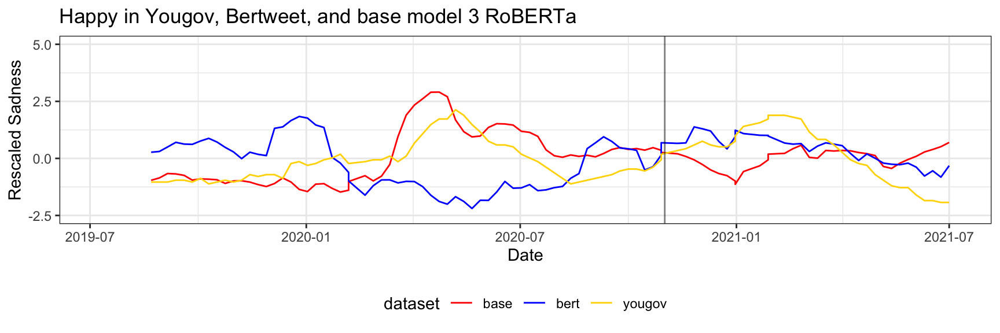
Bertweet FT vs . Baseline 3
Baseline 3 also almost aligns with GS

Slide 52
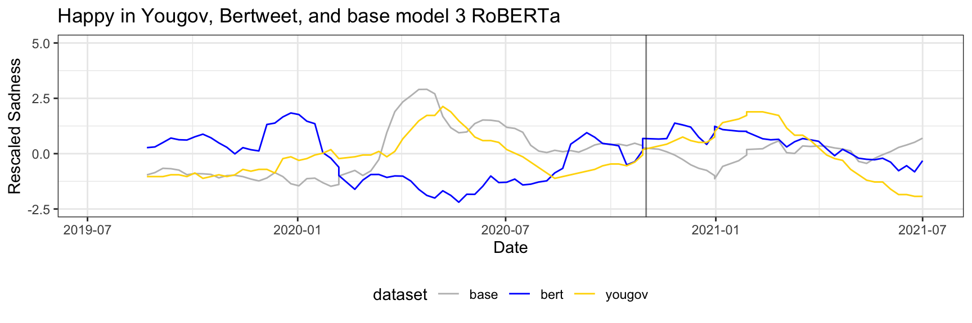
Bertweet FT vs . Baseline 3

Slide 53
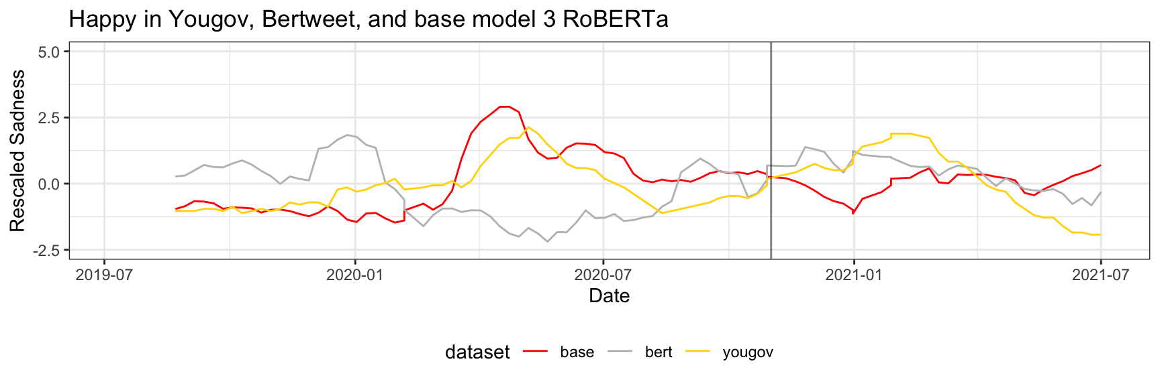
Bertweet FT vs . Baseline 3
Tends hard to spot due to high volatility and value predominantly stay in the middle

Slide 54
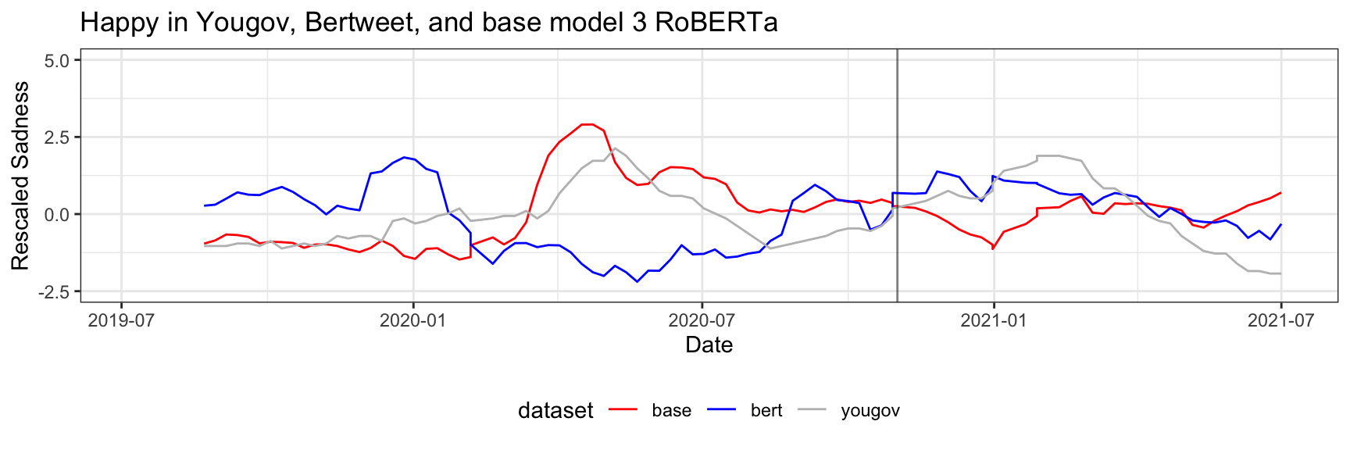
Bertweet FT vs . Baseline 3

Slide 55
Comparison
Matric | Tuned Model | LIWC | RoBERTa
Pearson's correlation
Correlation | 0.230536233 | 0.57118383 | 0.6987343 | Higher value is better
P Value | 0.112333333 | 0.00388 | 5.04357E-08 | Lower value is better
Adjusted R-squared | 0.078618037 | 0.6837 | 0.638933333 | Lower value is better
Permutation Correlation
Correlation | 0.2317299 | 0.38889683 | 0.499684033 | Higher value is better
P Value | 0.480416867 | 0.27040411 | 0.02857808 | Lower value is better
DCCA | 0.056985217 | 0.55681293 | 0.6885053 | Higher value is better
DCCA P Value | 0.7074 | 0.02243333 | 0.0001 | Lower value is better

Slide 56
Conclusion
Although the base model 1 contains some temporal information, the Training model with weekly data still outperforms the base model.
Masked model can not outperform existing Dictionary and sentiment base methods.
Making the model perform consistently and repeatably is still a challenge.
Results still have some amount of time lag. The lag between actual emotion and the time the survey result comes or the time the model trains and adapts according to the emotion can be varied.
Need to test one question where trends are more clear.

Slide 57
TimeLine
Week | Training Model | Analyzing result | Final Report writing
1 - 4 | Training model with different parameters. Fixed number of Data for each week Save the result in each epoch Use Different model(Bertweet) | Companion between multiple approaches Single query, multiple query. Number of epoch Similarity-based methods Compare the result with existing methods Compare the result with base model | Introduction and Motivation
4 - 8 |  |  | Related work and Research Gap
8 - 12 |  |  | Training and Experimental setup
12 | Mid Term Presentation
12 - 16 |  | Test if shifting time leads to better results. Experiment with different questions | Details explanation of the experimental setup
16 - 20 |  |  | Evaluation of Test Result
20-22 | Final proofreading & Incorporating feedback
22 | Final Presentation

Slide 58
Reference
References
Beasley, A., Mason, W., & Smith, E. R. (2016). Inferring emotions and self-relevant domains in social media: Challenges and future directions. In A. Beasley, W. Mason, & E. R. Smith, Translational Issues in Psychological Science (Vol. 2, Issue 3, p. 238). American Psychological Association. https://doi.org/10.1037/tps0000086
García, D., Pellert, M., Lasser, J., & Metzler, H. (2021). Social media emotion macroscopes reflect emotional experiences in society at large. In D. García, M. Pellert, J. Lasser, & H. Metzler, arXiv (Cornell University). Cornell University. https://doi.org/10.48550/arxiv.2107.13236
Mohammad, S. M., Bravo-Márquez, F., Salameh, M., & Kiritchenko, S. (2018). SemEval-2018 Task 1: Affect in Tweets. https://doi.org/10.18653/v1/s18-1001

Slide 59


Slide 60
The problem with current approach
Still dependent on the query. A slight change is query can give a completely different results.
Both result have some amount of time lag. The lag between actual emotion and time survey result come or the time the model train and adapt according to the emotion can be varied.
Result is not consistent with all query. It is giving quite similar result for some variable, but for other variable it is way different from the survey result.
If it has been working for one survey, it is not certain that it going to work for another survey.
Try other approach to see if it perform better.

Slide 61
Time-aware language models
Each model snapshot is trained on data from a distinct period, such as months or years, enabling it to capture the language and trends specific to that interval.
Use of TimeLM
Track language evolution: how language changes over time, especially on social media.
Trend analysis: Detects shifts in word usage, cultural references, or event-driven changes in language.
Temporal text classification: such as classifying tweets based on historical context.
Overall, TimeLM can perform tasks better when questions are being asked associated with that point in time.
For example, people's moods on COVID-19 can be best answered by a model trained on data at COVID-19 time.
Data Collection: TimeLMs uses large-scale Twitter data collected across multiple time periods to track how language changes over time.
Pretraining: The model is pretrained using masked language modeling on Twitter data from different snapshots to capture temporal language patterns.
Fine-tuning: It is fine-tuned for downstream tasks like sentiment analysis or event detection, leveraging its temporal knowledge.
Temporal Adaptation: TimeLMs can identify shifts in word meanings or trends by comparing data from different time periods.
Each model is fine-tuned on a separate dataset that represents a specific time period
In this research we will try to use the same approch but for diffierent purpose.
Introduction
Goal
Literature
Data
Methodology
Results

Slide 62
Trained new model
Trained the model with a lower learning rate to reduce the learning rate.
Tran the model with a much smaller epoch, three epoch instead of 5.
Saved the model at each epoch instead of the last one to compare if the training model will increase the performance or decrease it.
Tran each week with the same number of tweets each week rather than all available tweets.
Change the Model with a different model (Bertweet), which has been trained with data before 2019. So, there is no influence from the previous data.

Slide 63
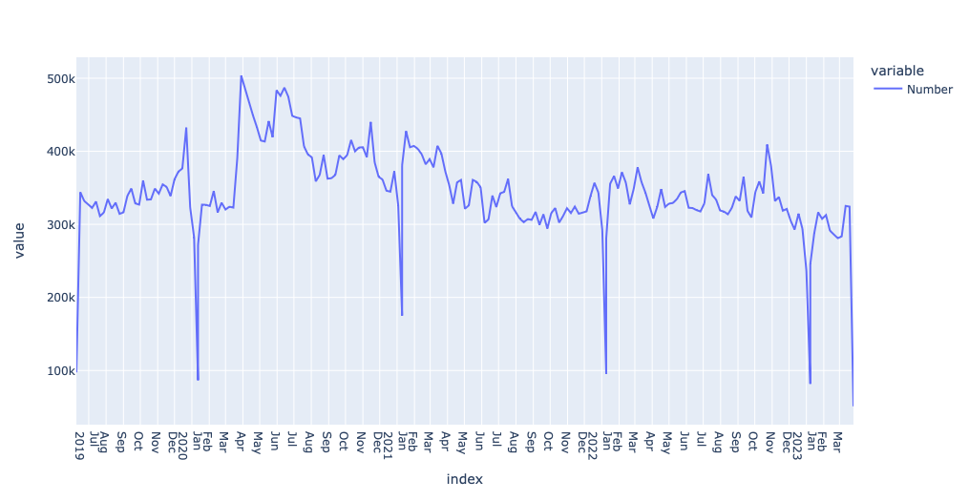
Data
The complete Twitter history of the users was extracted and split by week. Time: UK Twitter users January 2019 – March 2023 Hight and low activity are filtered out The data have been split into 200 weeks Total 70 million tweets, with an average of 350 thousand weekly tweets | Keep the training data the same at 200k by under-sampling and oversampling.

Slide 64
How many epochs are best for the training model?
Correlation
Emotion | Epoch 1 | Epoch 2 | Epoch 3 | Matric | Winner
Happy | -0.456024 | -0.4709758 | -0.4792121 | Correlation | E3 (Highest)
 | 4.123E-10 | 9.076E-11 | 3.819E-11 | P Value | E3 (Lowest)
 | 2.894919 | 2.924646 | 2.941022 | MSE | E1 (Lowest)
 | 0.2032435 | 0.2171862 | 0.2250588 | Adjusted R-squared | E3 (Height)
Sad | -0.085629 | -0.2000008 | -0.1027183 | Correlation | E2 (Highest)
 | 0.2585 | 0.007783 | 0.1749 | P Value | E1(Lowest)
 | 2.158921 | 2.386365 | 2.192906 | MSE | E1 (Lowest)
 | 0.0016273 | 0.0344831 | 0.004864563 | Adjusted R-squared | E2(Highest)
Stressed | 0.1958086 | 0.04470785 | 0.1096783 | Correlation | E1(Highest)
 | 0.01198 | 0.5697 | 0.1621 | P Value | E1 (Lowest)
 | 1.598576 | 1.898934 | 1.769786 | MSE | E1 (Lowest)
 | 0.0324048 | -0.00416171 | 0.005930748 | Adjusted R-squared | E1 (Highest)
Frustrated | -0.357121 | -0.4435597 | -0.4049925 | Correlation | E2(Highest)
 | 4.103E-06 | 5.317E-09 | 0.00000013 | P Value | E2 (Lowest)
 | 2.697063 | 2.868847 | 2.7922 | MSE | E1(Lowest)
 | 0.1219426 | 0.1915962 | 0.1586601 | Adjusted R-squared | E2(Highest)
Inspired | -0.274665 | -0.3379866 | -0.2676678 | Correlation | E2(Highest)
 | 0.000616 | 0.00002057 | 0.0008566 | P Value | E2(Lowest)
 | 2.532559 | 2.658368 | 2.518656 | MSE | E3 (Lowest)
 | 0.0692774 | 0.1083299 | 0.06545704 | Adjusted R-squared | E2(Highest)

Slide 65
How many epochs are best for the training model?
Correlation
Emotion | Epoch 1 | Epoch 2 | Epoch 3 | Matric | Winner
Apathetic | -0.236932 | -0.1746875 | -0.1616164 | Correlation | E1 (Highest)
 | 0.003985 | 0.03496 | 0.05131 | P Value | E1(Lowest)
 | 2.45692 | 2.333283 | 2.30732 | MSE | E3 (Lowest)
 | 0.0495823 | 0.02378321 | 0.01935682 | Adjusted R-squared | E1(Highest)
Lonely | -0.226392 | -0.22496 | -0.2094648 | Correlation | E1(Highest)
 | 0.007152 | 0.007535 | 0.013 | P Value | E1(Lowest)
 | 2.435263 | 2.432421 | 2.401652 | MSE | E3(Lowest)
 | 0.0443782 | 0.04372736 | 0.03694708 | Adjusted R-squared | E1(Highest)
Optimistic | -0.160221 | -0.1827178 | -0.1961645 | Correlation | E3(Highest)
 | 0.06442 | 0.03459 | 0.02311 | P Value | E3(Lowest)
 | 2.303125 | 2.347783 | 2.374476 | MSE | E1(Lowest)
 | 0.0182895 | 0.02606294 | 0.03119629 | Adjusted R-squared | E3(Highest)
Content | -0.341914 | -0.2339036 | -0.4150569 | Correlation | E3(Highest)
 | 7.812E-05 | 0.007876 | 0.000001108 | P Value | E1(Lowest)
 | 2.662861 | 2.448527 | 2.808003 | MSE | E2(Lowest)
 | 0.1098967 | 0.04720861 | 0.1657029 | Adjusted R-squared | E3(Highest)
Energetic | -0.010874 | -0.07563624 | -0.02028269 | Correlation | E2(Highest)
 | 0.9054 | 0.4077 | 0.8245 | P Value | E2(Lowest)
 | 2.005176 | 2.133639 | 2.023839 | MSE | E1(Lowest)
 | -0.008214 | -0.002564818 | -0.007918517 | Adjusted R-squared | E1(Highest)

Slide 66
How many epochs are best for the training model?
Permutation |  |  |  |  | Winner
Emotion | Epoch 1 | Epoch 2 | Epoch 3 | Matric
Happy | -0.38158 | -0.4373 | 0.2806 | correlation | E2
 | 0.2469 | 0.1786 | -0.3574 | p-value | E2
 | -0.05901 | -0.0659 | -0.0858 | DCCA | E3
 | 0.7149 | 0.7316 | 0.8049 | DCCA p-val | E1
Sad | -0.15386 | -0.0815 | 0.23489 | correlation | E3
 | 0.6515 | 0.8116 | 0.4869 | p-value | E3
 | -0.04147 | -0.0705 | -0.0618 | DCCA | E2
 | 0.6636 | 0.7614 | 0.7209 | DCCA p-val | E2
Stressed | 0.195041 | 0.04066 | 0.1797 | correlation | E1
 | 0.5655 | 0.9055 | 0.597 | p-value | E1
 | -0.02594 | -0.0531 | -0.0233 | DCCA | E2
 | 0.5915 | 0.7131 | 0.5964 | DCCA p-val | E2
Frustrated | -0.09306 | -0.3122 | -0.399 | correlation | E3
 | 0.7855 | 0.3499 | 0.2241 | p-value | E3
 | -0.08239 | -0.14 | -0.0388 | DCCA | E2
 | 0.7792 | 0.9088 | 0.6302 | DCCA p-val | E2
Inspired | 0.511562 | 0.39188 | 0.4351 | correlation | E1
 | 0.1077 | 0.2333 | 0.1811 | p-value | E2
 | 0.083431 | 0.0641 | 0.15849 | DCCA | E3
 | 0.2278 | 0.1659 | 0.0708 | DCCA p-val | E3

Slide 67
How many epochs are best for the training model?
Permutation |  |  |  |  | Winner
Emotion | Epoch 1 | Epoch 2 | Epoch 3 | Matric
Apathetic | 0.448185 | 0.37564 | 0.37912 | correlation | E1
 | 0.1668 | 0.2549 | 0.2502 | p-value | E1
 | 0.225701 | 0.0412 | 0.05369 | DCCA | E1
 | 0.9989 | 0.3555 | 0.3137 | DCCA p-val | E3
Lonely | -0.05863 | -0.0225 | 0.08897 | correlation | E3
 | 0.864 | 0.9477 | 0.7948 | p-value | E3
 | -0.12532 | -0.0985 | -0.1289 | DCCA | E3
 | 0.8724 | 0.8361 | 0.88 | DCCA p-val | E3
Optimistic | 0.646266 | 0.58159 | 0.68123 | correlation | E3
 | 0.03168 | 0.06055 | 0.021 | p-value | E3
 | 0.138848 | 0.04268 | 0.06946 | DCCA | E1
 | 0.1088 | 0.3517 | 0.2648 | DCCA p-val | E1
Content | -0.57748 | -0.6599 | -0.5828 | correlation | E3
 | 0.06283 | 0.02714 | 0.05986 | p-value | E2
 | -0.08575 | 0.04963 | -0.1469 | DCCA | E3
 | 0.7703 | 0.3 | 0.8882 | DCCA p-val | E2
Energetic | 0.01267 | 0.42019 | 0.76163 | correlation | E3
 | 0.71888 | 0.1982 | 0.00645 | p-value | E3
 | 0.021823 | 0.04434 | 0.5885 | DCCA | E3
 | 0.445 | 0.3581 | 0.4741 | DCCA p-val | E2

Slide 68
How many epochs give the best results
 | Epoch 1 | Epoch 2 | Epoch 3 |  | Epoch 1 | Epoch 2 | Epoch 3
Correlation | 4 | 5 | 3 | Correlation | 3 | 1 | 8
P Value | 6 | 4 | 2 | p-value | 1 | 4 | 6
MSE | 7 | 2 | 3 | DCCA | 3 | 4 | 5
Adjusted R-squared | 5 | 4 | 3 | DCCA p-val | 1 | 5 | 5
Single epoch leads to less overfitting

Slide 69
Single query vs Multiple query
Correlation
Emotion | Single | Multi | Matric
Happy | -0.4560241 | -0.455187 | Correlation | singe
 | 4.123E-10 | 4.478E-10 | P Value | singe
 | 2.894919 | 2.893255 | MSE | Multi
 | 0.2032435 | 0.2024764 | Adjusted R-squared | Multi
Sad | -0.08562889 | -0.085404 | Correlation | singe
 | 0.2585 | 0.2597 | P Value | singe
 | 2.158921 | 2.158474 | MSE | Multi
 | 0.00162732 | 0.0015886 | Adjusted R-squared | singe
Stressed | 0.1958086 | 0.1926067 | Correlation | singe
 | 0.01198 | 0.01348 | P Value | singe
 | 1.598576 | 1.60494 | MSE | singe
 | 0.03240484 | 0.0311535 | Adjusted R-squared | singe
Frustrated | -0.3571209 | -0.312435 | Correlation | singe
 | 0.000004103 | 6.426E-05 | P Value | Multi
 | 2.697063 | 2.608258 | MSE | Multi
 | 0.1219426 | 0.0918313 | Adjusted R-squared | singe
Inspired | -0.2746654 | -0.271084 | Correlation | singe
 | 0.000616 | 0.0007301 | P Value | singe
 | 2.532559 | 2.525443 | MSE | Multi
 | 0.06927735 | 0.0673097 | Adjusted R-squared | singe
Apathetic | -0.2369323 | 0.1599376 | Correlation | singe
 | 0.003985 | 0.05381 | P Value | singe
 | 2.45692 | 1.668617 | MSE | Multi
 | 0.04958231 | 0.0188132 | Adjusted R-squared | singe

Slide 70
Single query vs Multiple query
Correlation
Emotion | Single | Multi | Matric
Lonely | -0.2263917 | -0.226291 | Correlation | singe
 | 0.007152 | 0.007178 | P Value | singe
 | 2.435263 | 2.435064 | MSE | singe
 | 0.04437821 | 0.0443324 | Adjusted R-squared | singe
Optimistic | -0.160221 | -0.382811 | Correlation | Multi
 | 0.06442 | 4.996E-06 | P Value | Multi
 | 2.303125 | 2.744984 | MSE | singe
 | 0.0182895 | 0.1400789 | Adjusted R-squared | Multi
Content | -0.3419143 | -0.341327 | Correlation | singe
 | 0.00007812 | 8.051E-05 | P Value | Multi
 | 2.662861 | 2.661696 | MSE | Multi
 | 0.1098967 | 0.1094923 | Adjusted R-squared | Multi
Energetic | -0.01087405 | 0.0145797 | Correlation | Multi
 | 0.9054 | 0.8734 | P Value | Multi
 | 2.005176 | 1.954686 | MSE | Multi
 | -0.008214103 | -0.008119 | Adjusted R-squared | Multi
Frustrated | -0.012121 | 0.05416 | Correlation | Multi
 | 0.8972 | 0.5637 | P Value | Multi
 | 2.006792 | 1.875372 | MSE | Multi
 | -0.008623722 | -0.005813 | Adjusted R-squared | singe
Bored | 0.295546 | 0.2967839 | Correlation | Multi
 | 0.001721 | 0.00164 | P Value | Multi
 | 1.3961 | 1.393646 | MSE | Multi
 | 0.07889694 | 0.07963697 | Adjusted R-squared | Multi

Slide 71
Single query vs Multiple query
Permutation
Emotion | Single | Multi | Matric
Happy | -0.381576 | -0.3814941 | cor | Single
 | 0.2469 | 0.247 | p-value | Single
 | -0.05900618 | -0.05947214 | DCCA | Multi
 | 0.7149 | 0.7253 | DCCA p-val | Single
Sad | -0.1538559 | -0.1530372 | cor | Single
 | 0.6515 | 0.6533 | p-value | Single
 | -0.04147452 | -0.04095681 | DCCA | single
 | 0.6636 | 0.649 | DCCA p-val | Multi
Stressed | 0.1950405 | 0.19651 | cor | Multi
 | 0.5655 | 0.5625 | p-value | Multi
 | -0.02594146 | -0.02602831 | DCCA | Multi
 | 0.5915 | 0.5979 | DCCA p-val | Single
Frustrated | -0.09305838 | -0.04842116 | cor | Single
 | 0.7855 | 0.8876 | p-value | Single
 | -0.0823871 | -0.06953398 | DCCA | Single
 | 0.7792 | 0.7497 | DCCA p-val | Multi
Inspired | 0.511562 | 0.5119524 | cor | Multi
 | 0.1077 | 0.1074 | p-value | Multi
 | 0.08343065 | 0.08328031 | DCCA | Single
 | 0.2278 | 0.2308 | DCCA p-val | Single
Apathetic | 0.4481853 | 0.2019278 | cor | Single
 | 0.1668 | 0.5516 | p-value | Single
 | 0.2257013 | -0.1355965 | DCCA | Single
 | 0.9989 | 0.8928 | DCCA p-val | Multi

Slide 72
Single query vs Multiple query
Permutation
Emotion | Single | Multi | Matric
Lonely | -0.05862869 | -0.05833341 | cor | Single
 | 0.864 | 0.8647 | p-value | Single
 | -0.1253211 | -0.1254389 | DCCA | Multi
 | 0.8724 | 0.8601 | DCCA p-val | Multi
Optimistic | 0.6462659 | 0.3630217 | cor | Single
 | 0.03168 | 0.2725 | p-value | Single
 | 0.1388483 | -0.01889189 | DCCA | Single
 | 0.1088 | 0.5701 | DCCA p-val | Single
Content | -0.5774764 | -0.5763883 | cor | Multi
 | 0.06283 | 0.06345 | p-value | Single
 | -0.08575007 | -0.08579313 | DCCA | Multi
 | 0.7703 | 0.7705 | DCCA p-val | Single
Energetic | 0.01267 | 0.708586 | cor | Multi
 | 0.7188797 | 0.01465 | p-value | Multi
 | 0.02182332 | 0.001909378 | DCCA | Single
 | 0.445 | 0.5 | DCCA p-val | Single
Frustrated | -0.09305838 | -0.04842116 | cor | Single
 | 0.7855 | 0.8876 | p-value | Single
 | -0.1729222 | -0.149053 | DCCA | Single
 | 0.9071 | 0.8727 | DCCA p-val | Multi
Bored | -0.1456278 | -0.1447323 | cor | Single
 | 0.6692 | 0.6711 | p-value | Single
 | 0.2479137 | 0.2481694 | DCCA | Single
 | 0.0334 | 0.0335 | DCCA p-val | Single

Slide 73
Multiple Token Similarity base
Correlation
Emotion | Tuned Model | Base Model | Matric
Happy | -0.47921 | -0.20798 | Correlation | FT
 | 3.82E-11 | 0.006498 | P Value | FT
 | 2.941022 | 2.401743 | MSE | Base
 | 0.225059 | 0.03756 | Adjusted R-squared | FT
Sad | -0.10272 | -0.03931 | Correlation | FT
 | 0.1749 | 0.6044 | P Value | FT
 | 2.192906 | 2.066819 | MSE | Base
 | 0.004865 | -0.00419 | Adjusted R-squared | FT
Stressed | 0.109678 | -0.0574 | Correlation | FT
 | 0.1621 | 0.4654 | P Value | FT
 | 1.769786 | 2.101904 | MSE | FT
 | 0.005931 | -0.00286 | Adjusted R-squared | FT
Frustrated | -0.40499 | -0.14478 | Correlation | FT
 | 1.3E-07 | 0.06953 | P Value | FT
 | 2.7922 | 2.275063 | MSE | Base
 | 0.15866 | 0.014685 | Adjusted R-squared | FT
Inspired | -0.26767 | -0.37333 | Correlation | Base
 | 0.000857 | 2.17E-06 | P Value | Base
 | 2.518656 | 2.728591 | MSE | FT
 | 0.065457 | 0.133638 | Adjusted R-squared | Base

Slide 74
Can if actually predict the result
Correlation
Emotion | Tuned Model | Base Model | Matric
Inspired | -0.26767 | -0.37333 | Corelation | Base
 | 0.000857 | 2.17E-06 | P Value | Base
 | 2.518656 | 2.728591 | MSE | FT
 | 0.065457 | 0.133638 | Adjusted R-squared | Base
Apathetic | -0.16162 | 0.047494 | Corelation | FT
 | 0.05131 | 0.5692 | P Value | FT
 | 2.30732 | 1.891963 | MSE | Base
 | 0.019357 | -0.00467 | Adjusted R-squared | FT
Lonely | -0.20946 | 0.023781 | Corelation | FT
 | 0.013 | 0.7803 | P Value | FT
 | 2.401652 | 1.938493 | MSE | Base
 | 0.036947 | -0.00668 | Adjusted R-squared | FT
Optimistic | -0.19616 | -0.15648 | Corelation | FT
 | 0.02311 | 0.07099 | P Value | FT
 | 2.374476 | 2.295699 | MSE | Base
 | 0.031196 | 0.017096 | Adjusted R-squared | FT
Content | -0.41506 | -0.02651 | Corelation | FT
 | 1.11E-06 | 0.7664 | P Value | FT
 | 2.808003 | 2.036982 | MSE | Base
 | 0.165703 | -0.00723 | Adjusted R-squared | FT

